Slide 1

WEB DESIGNING PROJECT TESLA CLONE WEBSITE
WELCOME TO THE WORLD OF TESLA WHER CAR MEETS TECHNOLOGY.
DISCOVER THE ELECTRICAL VEHICLE BEASTS THAT ARE TRENDY, GOOD LOOKING AND ENVIRONMENT FRIENDLY.
BY:
ANKIT KANDULNA ANIKET KUMAR
(23/CS/060) (23/CS/051)

Slide 2
INTRODUCTION
The purpose of this report is to outline the development plan for a Tesla clone website. The objective is to create an online platform that mirrors the functionality and user experience of the original Tesla website, offering customers a seamless shopping experience while ensuring the website's security, responsiveness, and user-friendly interface.

Slide 3
PROJECT SCOPE
1. Mirrors the official TESLA website
website that replicates the look and feel of TESLA official website.
2. Incorporate a User-Friendly
interface and seamless navigation to enhance the user experience.
3. Integrate advance features
such as personalized interior, 3-D view of car.

Slide 4
FEATURES AND FUNCTIONALITY
LUXURY CARS
Explore an extensive range of luxury cars, AI driven with autopilot features.
USER PROFILES
Allows the user to fill in account details and register.
PERCEPTION
Gives the brief idea of the EV brand TESLA
COMFORT
Eases customer’s lives as they can save time and energy by ordering online and customer support is available 24*7.

Slide 5
TECHNOLOGY USED
HTML 5
HTML5 is the latest version of the standard language for creating websites and web applications. It introduces new features, including multimedia support, enhanced semantics, and improved interactivity, enhancing web development capabilities.
CSS3
CSS3, is the latest version of the CSS language. It enhances web design by offering advanced styling options, animations, transitions, responsive layouts, and flexible typography for creating visually appealing and responsive websites across various devices.

Slide 6
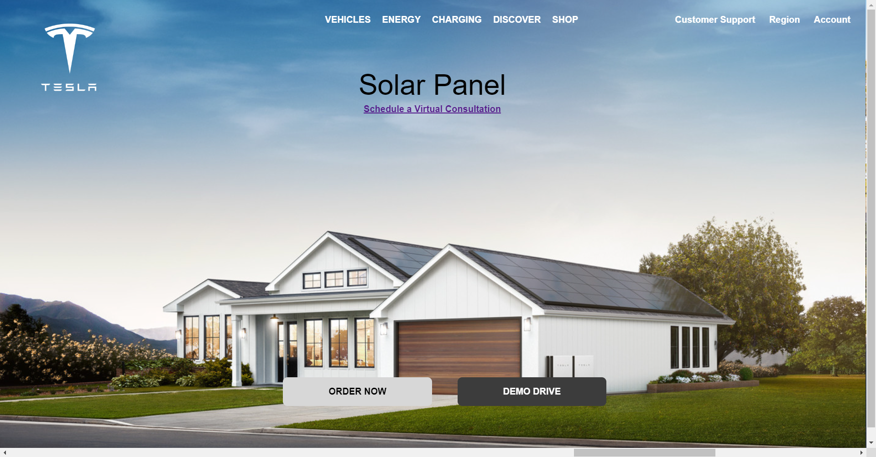
HOME PAGE
Home Page is designed using html tags such as img, list, button, anchor and paragraph tag which later on are styled by CSS by changing the background-color, text-color, padding, margin and many other CSS Properties.

Slide 7
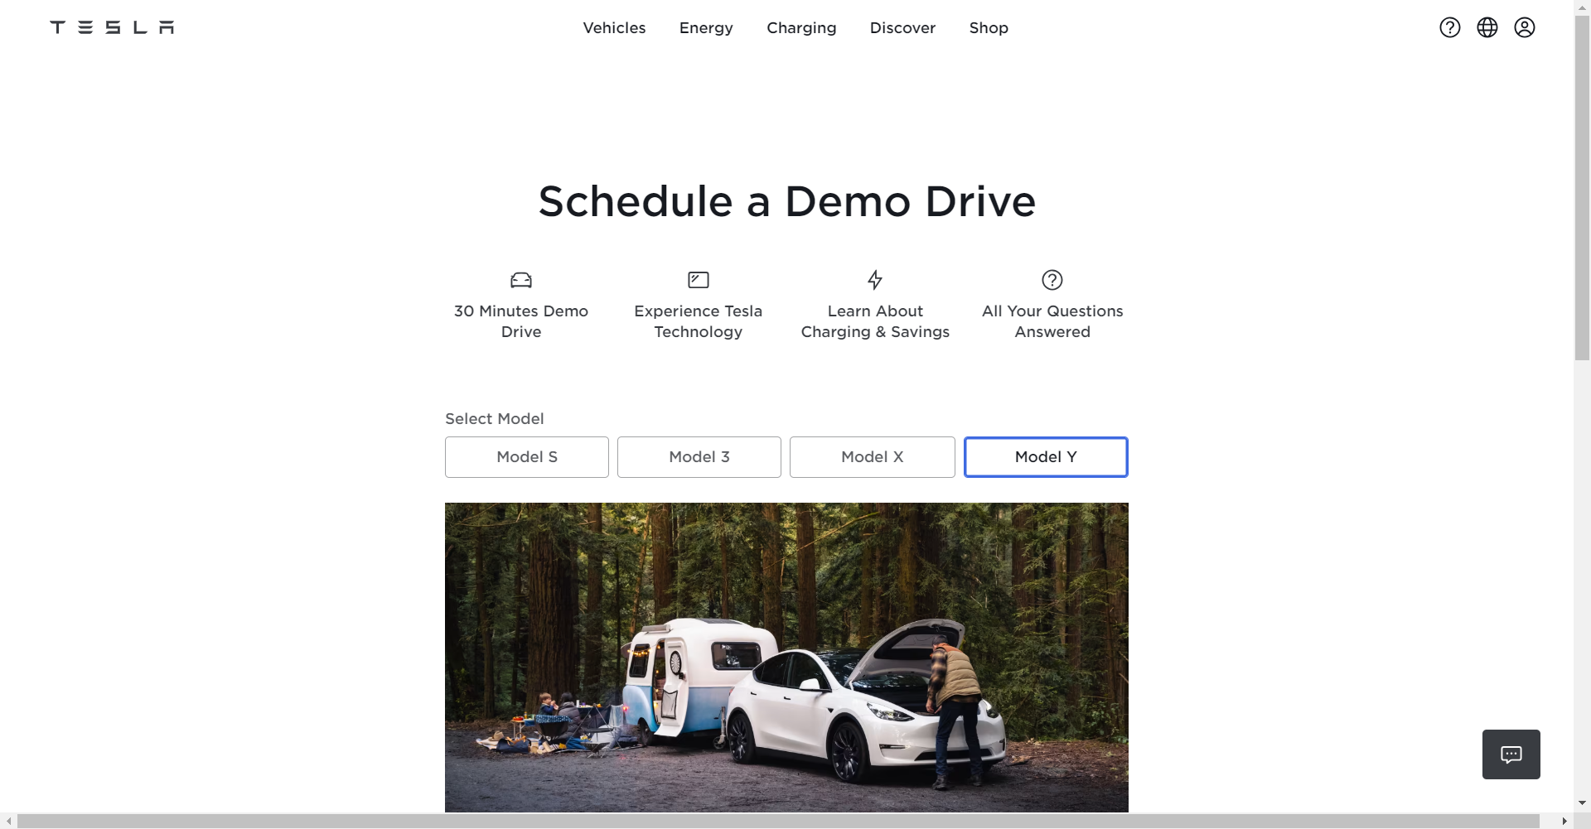
DEMO DRIVE
The Demo Drive feature redirects the user to official Tesla’s Website.

Slide 8
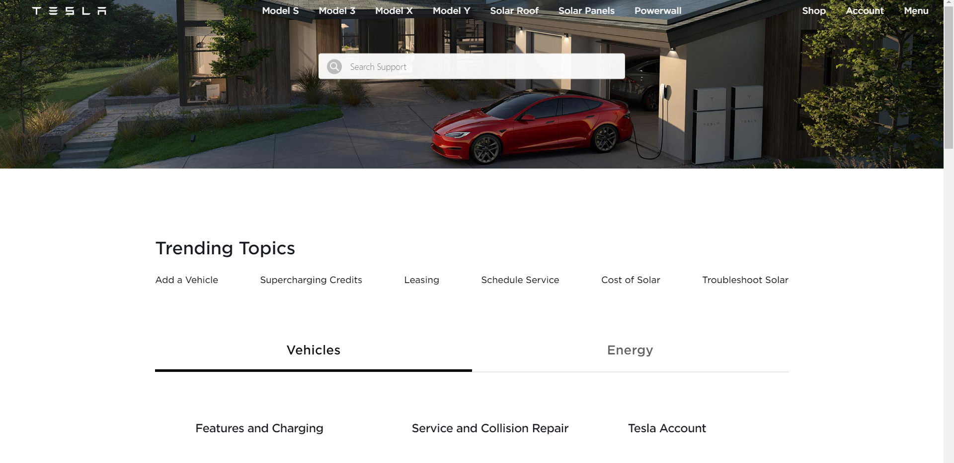
CUSTOMER SUPPORT
The Customer Support feature redirects you to customer support page through which you can customize your order.

Slide 9
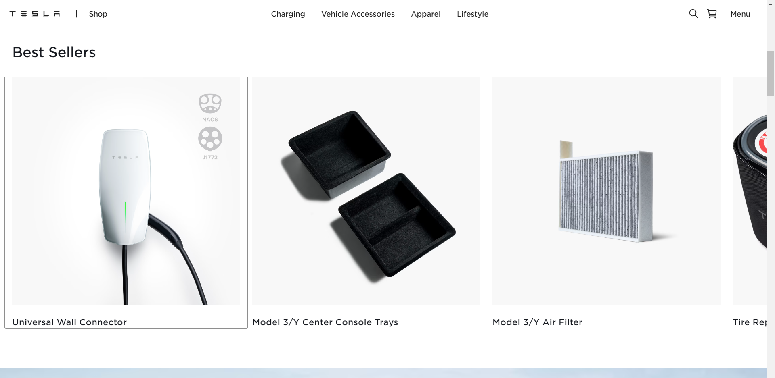
SHOP
The Shop feature enables you to explore more and buy extra accessories needed for car.

Slide 10

CONCLUSION
With its innovative features, stunning graphical user interface, and commitment to customer satisfaction, the Tesla Clone website aims to revolutionize online Car Delivery.

